Slide 1

Machine Learning Fundamentals

Slide 2
Machine Learning Foundations
scikit-learn Intro
ML Workflow
Types of ML
Traditional vs ML
What is ML?

Slide 3
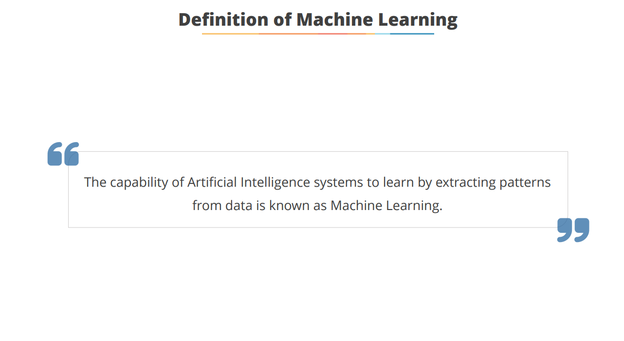
Machine Learning Journey
Initial
Understanding
Practical
Application
Learning Types
Model Building
Hands-on
Exposure
Basic ML concepts
Exploring
supervised,
unsupervised,
reinforcement
Understanding the
workflow
Applying ML to
business projects
Using Python
libraries

Slide 4
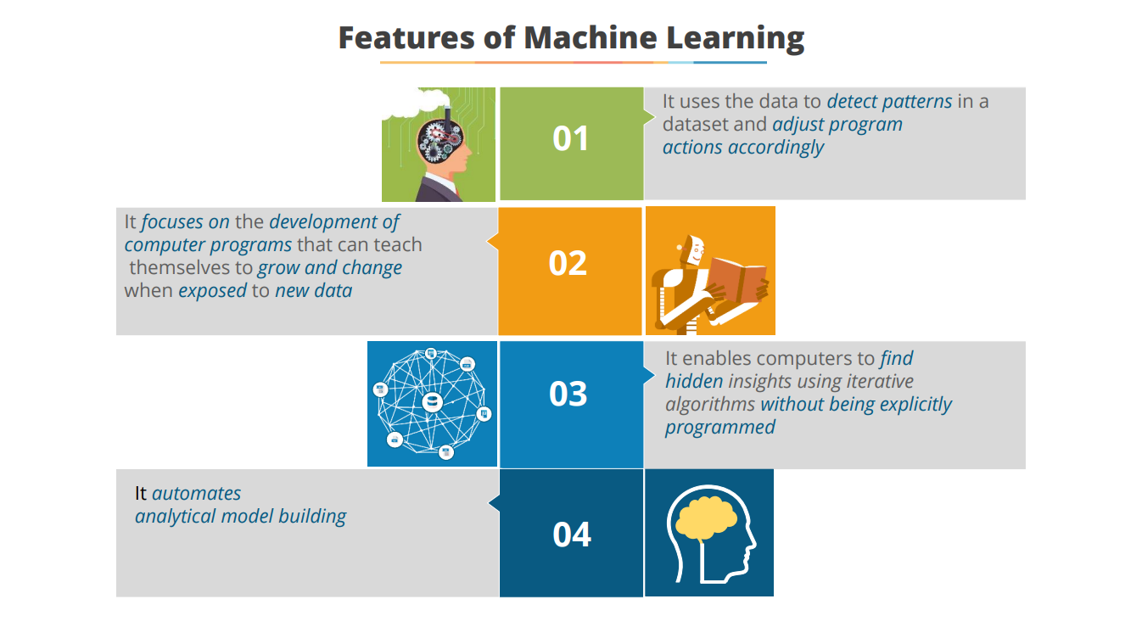

Slide 5
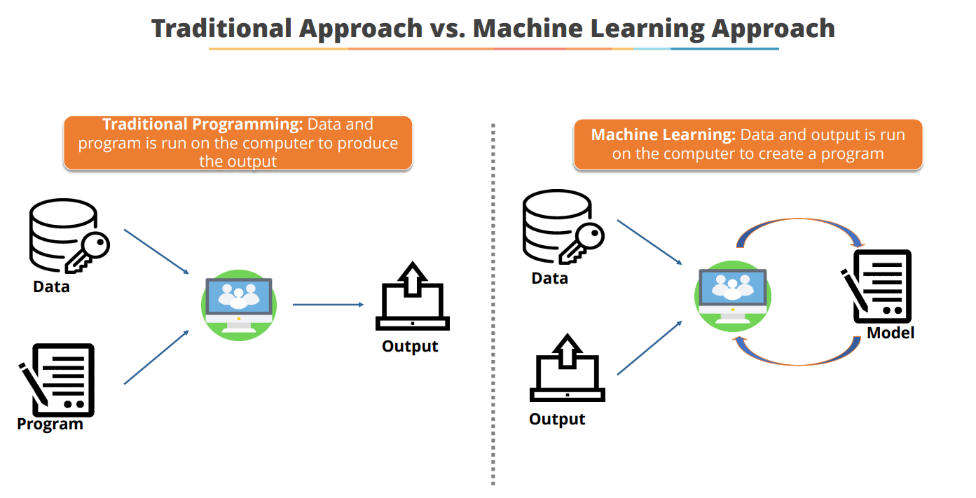

Slide 6
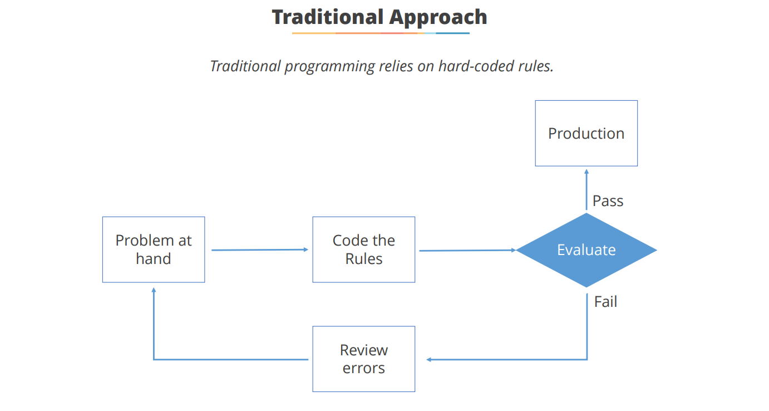

Slide 7
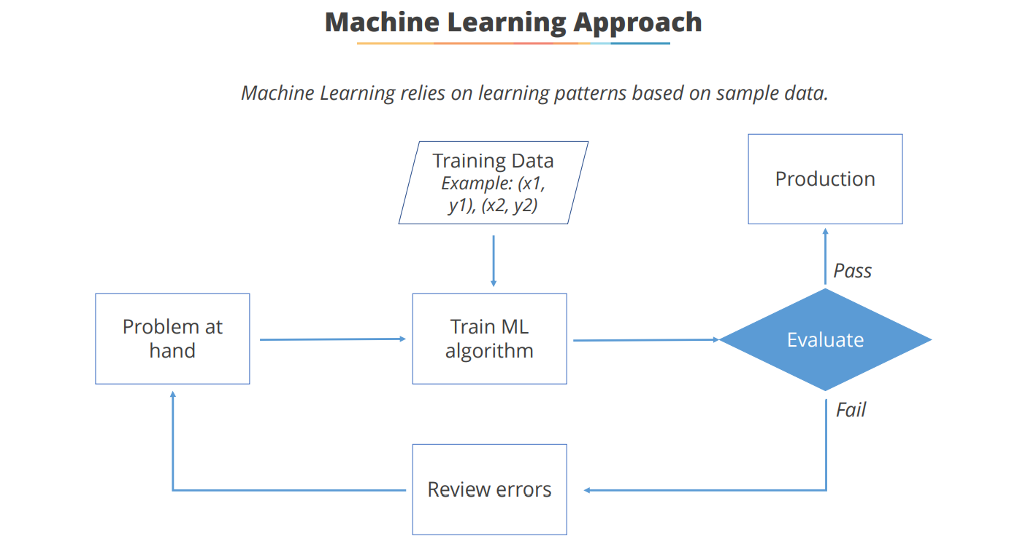

Slide 8
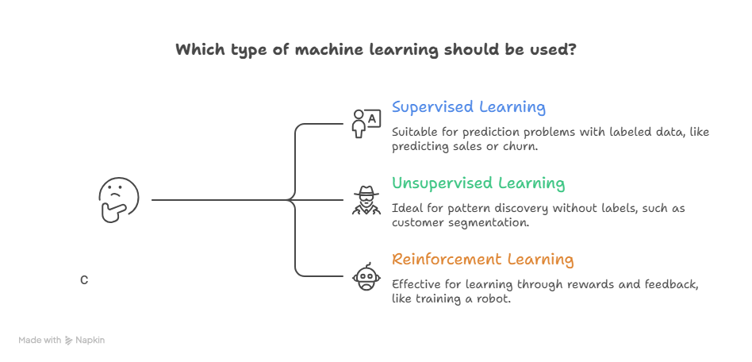

Slide 9
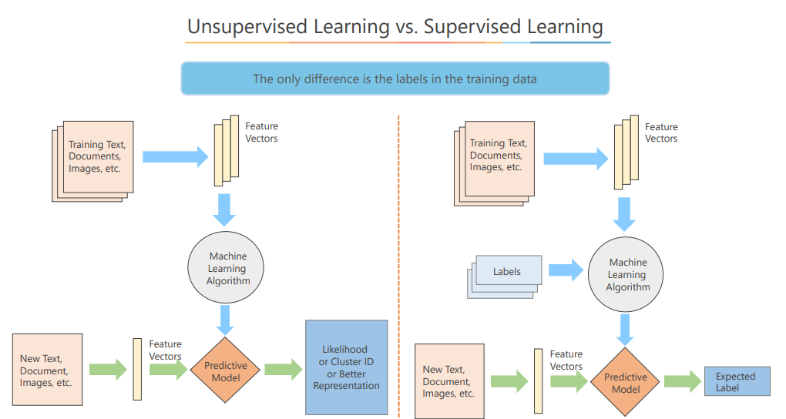

Slide 10
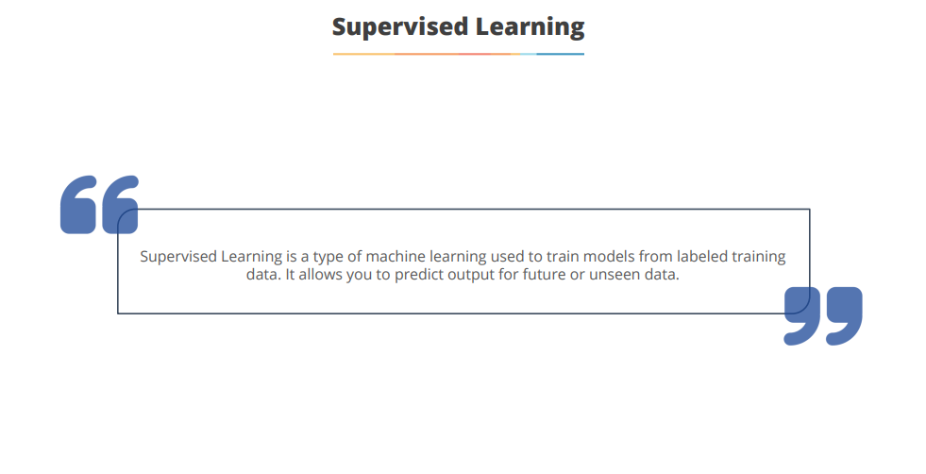

Slide 11
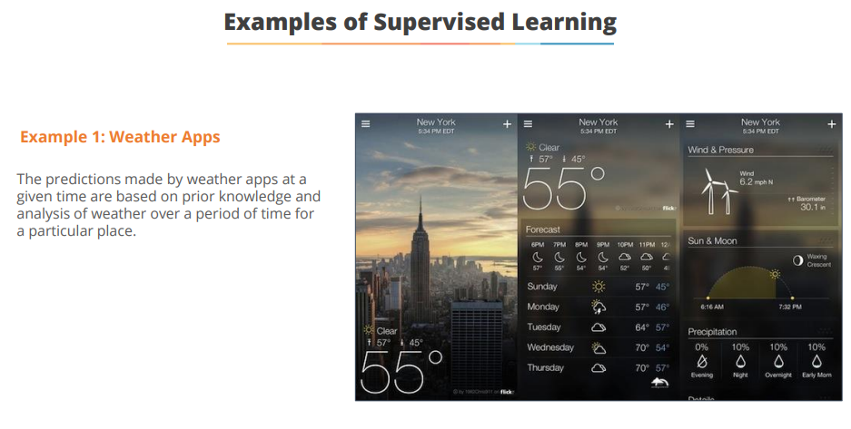
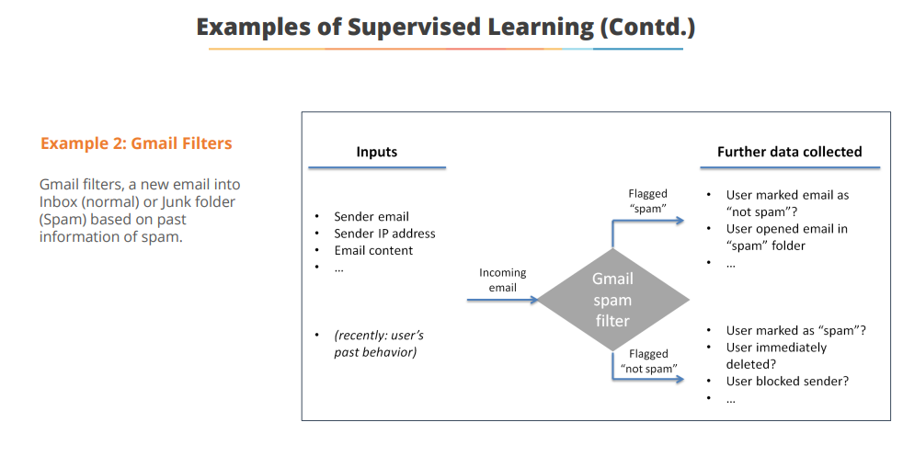

Slide 12
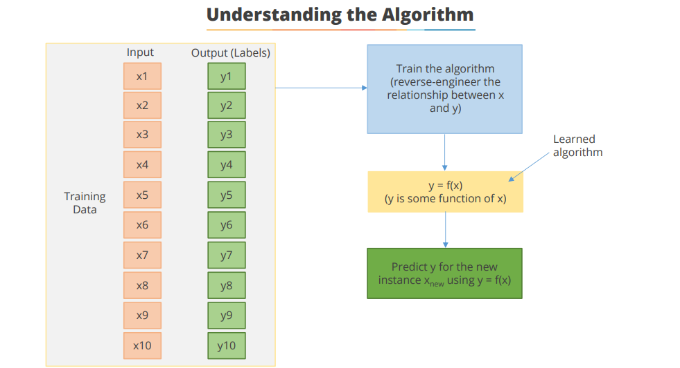

Slide 13
 | age | time_spent | pages_viewed | clicks | sentiment_score | engagement_score | survey_response
0 | 56 | 6.024771 | 16 | 2 | -0.848946 | 7.809908 | 0
1 | 46 | 13.219156 | 3 | 12 | 0.655162 | 9.787663 | 0
2 | 32 | 13.141028 | 10 | 6 | -0.144662 | 10.056411 | 0
3 | 60 | 9.114213 | 6 | 13 | 0.192128 | 9.345685 | 0
4 | 25 | 10.050655 | 18 | 10 | -0.820696 | 12.420262 | 1

Slide 14
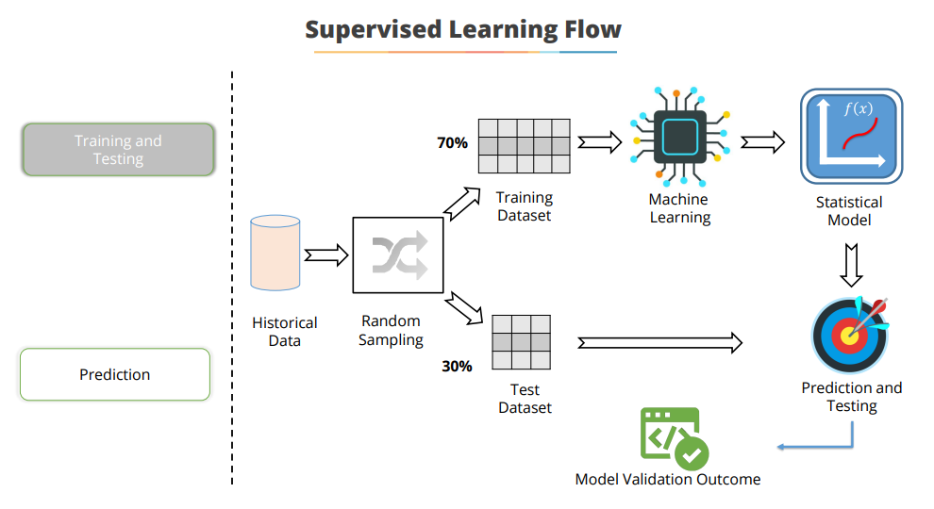

Slide 15
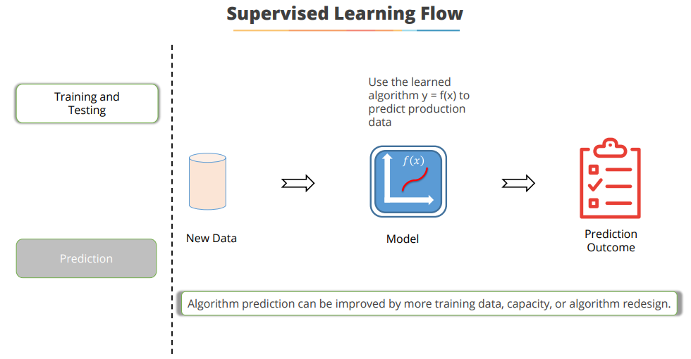

Slide 16
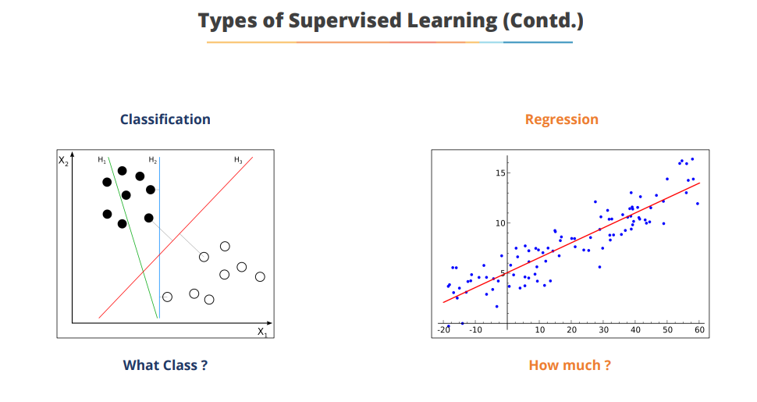

Slide 17
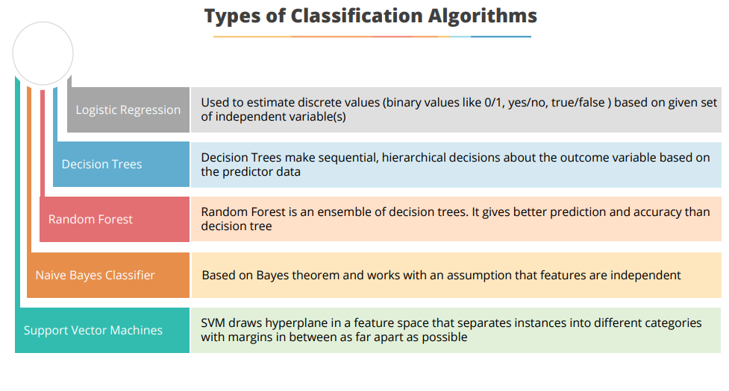

Slide 18
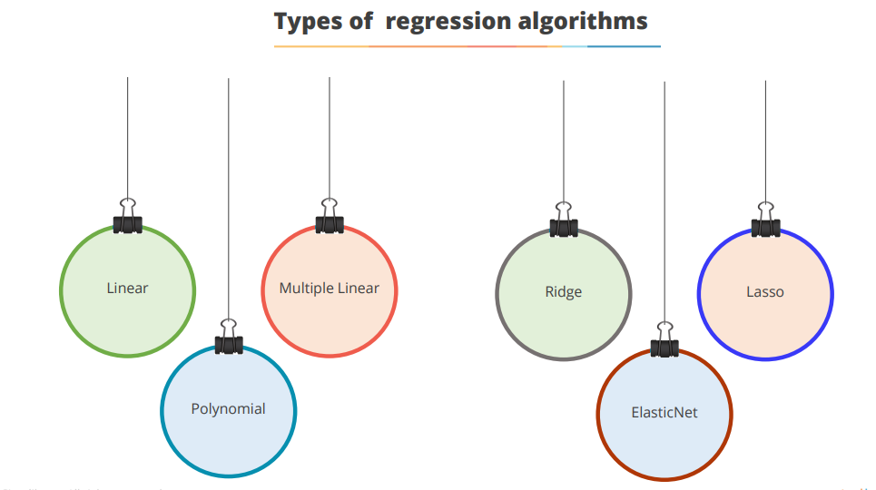

Slide 19
